Slide 1


Confirming the presence of a SMBHB in OJ 287 using multi-wavelength observations
Lankeswar Dey,
TIFR, Mumbai
May 19, 2021

Slide 2
Plan of my talk
Introduction
Properties of OJ 287: Binary Black Hole central engine
History of observational campaigns and predictions
2019 Spitzer observations of OJ 287
OJ 287 in Radio: Implications for the GMVA/EHT consortia
Modelling GWs from OJ 287 like binaries for PTA
Summary

Slide 3
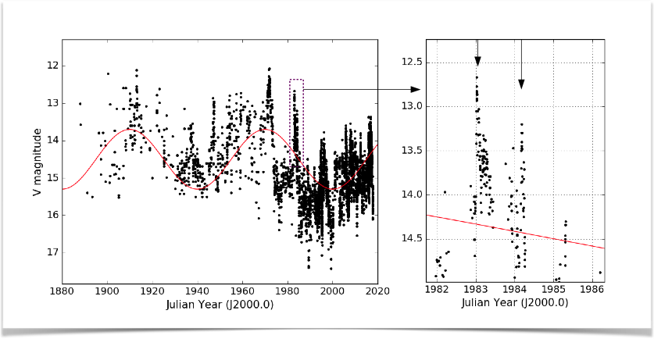
OJ 287: Light curve
OJ 287 is a bright blazar (z = 0.306), situated near the ecliptic
We can infer the presence of major flares ( ~ 1 year duration) that repeats in ~ 12 years
Doubly-peaked flares (duration ~1 month) superposed on these major flares
Presence of SMBH binary in OJ 287?
Dey et al. 2018, ApJ
Introduction 2019 Spitzer Observation OJ 287 in Radio GWs from OJ 287 .

Slide 4
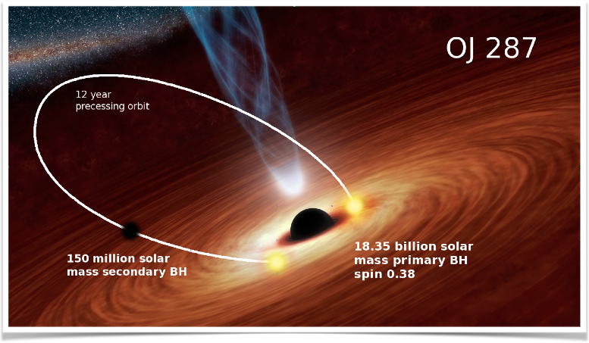
OJ 287: Binary Black Hole central engine
A supermassive black hole (BH) is orbiting a more massive primary BH in a precessing eccentric orbit with an orbital period of 12 years
(Lehto & Valtonen, 1996)
The doubly-peaked flares are due to the impacts of the secondary BH with the accretion disk of the primary BH.
Major flares are due to the tidal interactions of the secondary BH
Introduction 2019 Spitzer Observation OJ 287 in Radio GWs from OJ 287 .

Slide 5
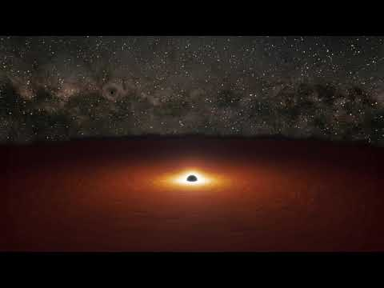
Credit:
Spitzer center, Abhimanyu Sosobhanan
The flares provide us fixed points on its relativistic binary orbit.

Slide 6
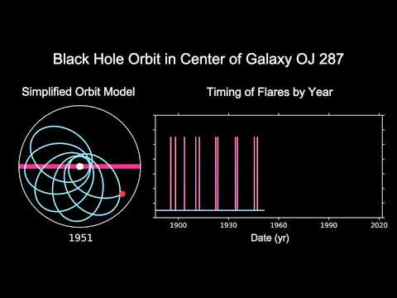
Flares provide us fixed phase points of secondary BH’s relativistic eccentric orbit
Credit:
Abhimanyu Sosobhanan,
Spitzer center

Slide 7
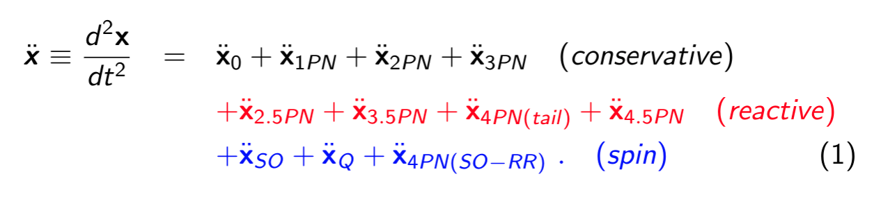

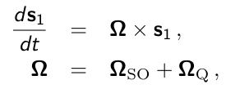

OJ 287: Parameter estimations
We use post-Newtonian equations of motion (EOM) to solve for the binary orbit and use the outburst times as fixed phase points on the orbit.
n
Spin of the primary BH precesses according to
where
Introduction 2019 Spitzer Observation OJ 287 in Radio GWs from OJ 287 .

Slide 8
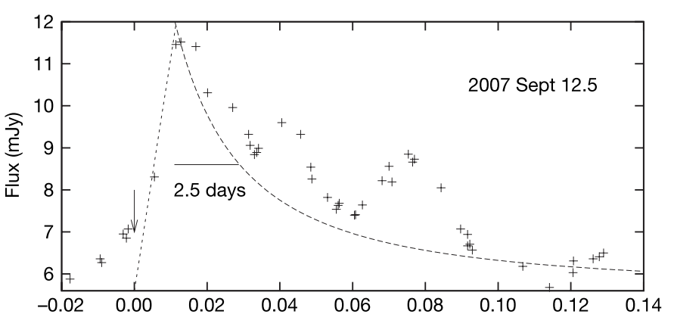
The 2007 flare: evidence for GW emission
In past, 2.5 PN accurate (non-spinning) EOM were used to predict the arrival time of the 2007 impact flare (Valtonen, 2007)
The peak of the 2007 impact flare was observed on September 13, 2007
The peak would have appear 20 days later if there was no GW emission
Valtonen et al. 2008, Nature
Introduction 2019 Spitzer Observation OJ 287 in Radio GWs from OJ 287 .

Slide 9
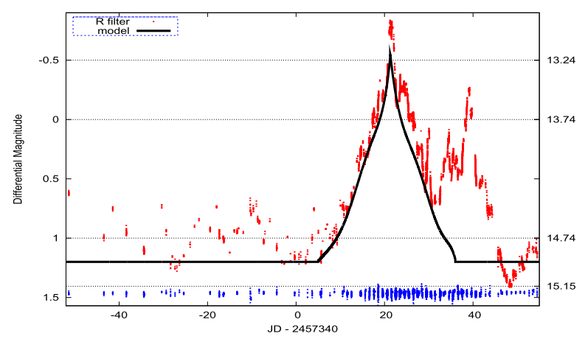
The 2015 flare: spin of the primary BH
The 2015 impact flare arrived within the expected time window, peaking on December 5, 2015
Its timing provided the estimation of primary BH spin (χ₁ ~ 0.31)
Valtonen et al. 2016, ApJL
Introduction 2019 Spitzer Observation OJ 287 in Radio GWs from OJ 287 .

Slide 10
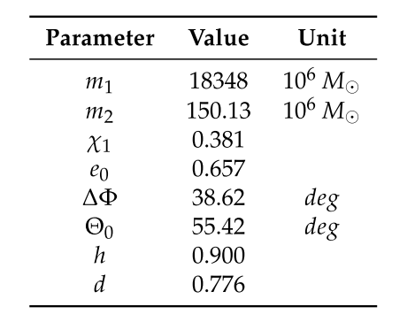
4.5 PN accurate solution
In Dey et al. 2018, we used 4.5 PN accurate EOM to calculate the parameters based on 10 well observed flares.
Based on our solutions, we predicted that the next flare will occur during end of July - early August, 2019 (Eddington Flare).
Dey et al. 2018, ApJ
Introduction 2019 Spitzer Observation OJ 287 in Radio GWs from OJ 287 .

Slide 11
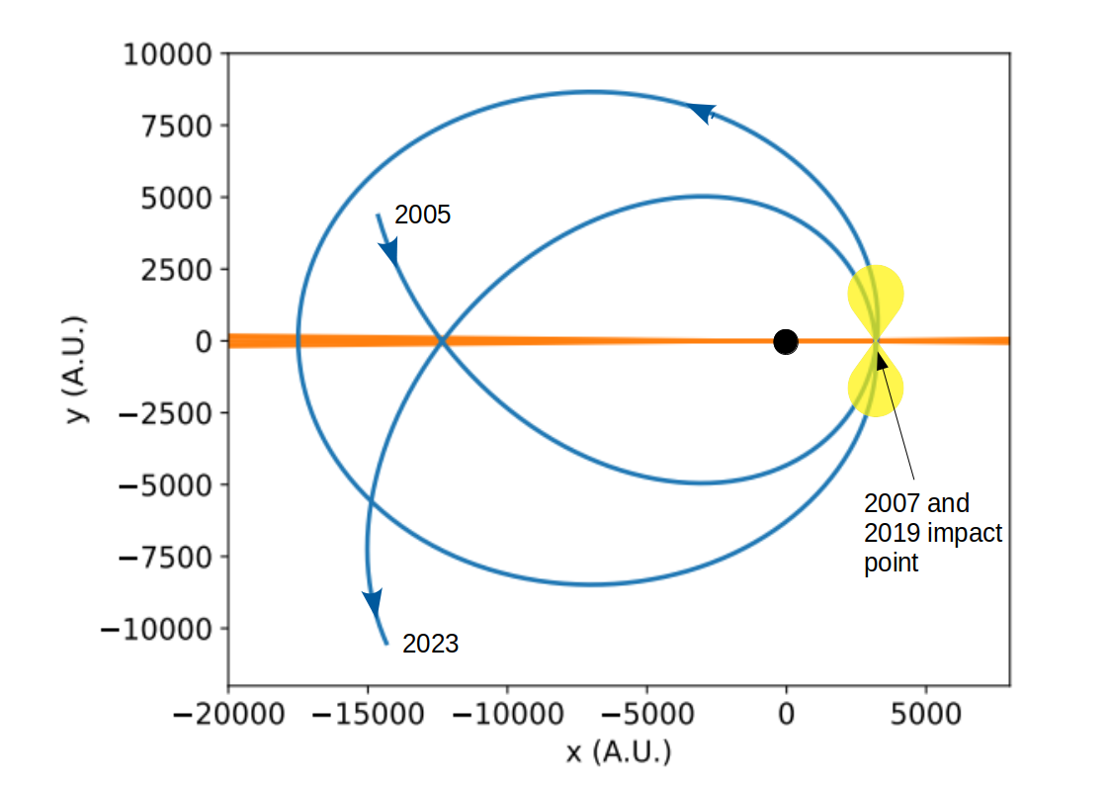
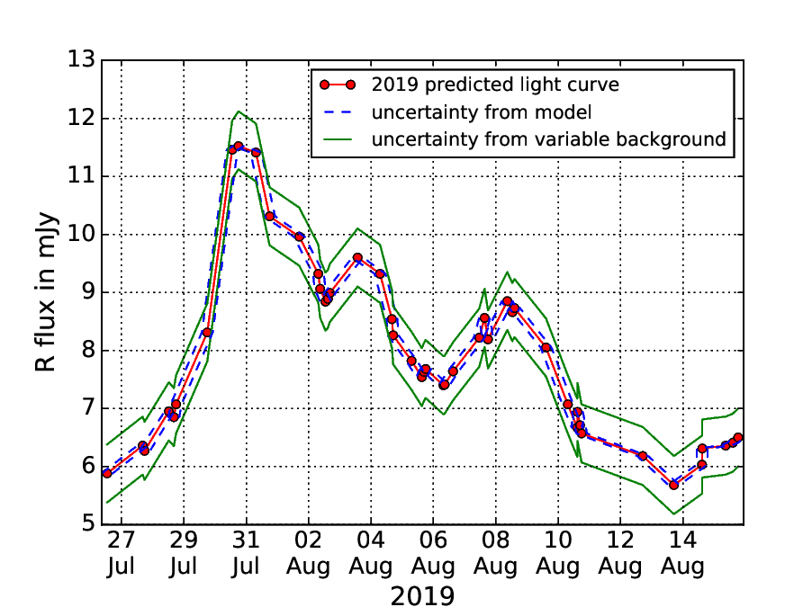
OJ 287: Predicting the 2019 Flare
We also predicted the expected shape of the light curve during 2019 flare.
Dey et al. 2018, ApJ
Introduction 2019 Spitzer Observation OJ 287 in Radio GWs from OJ 287 .

Slide 12
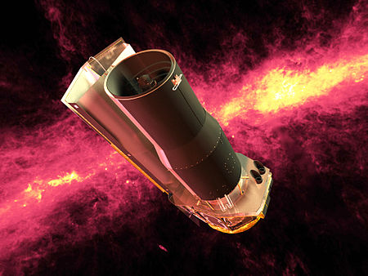
The Spitzer Observations
Unfortunately, at the time of predicted flare, OJ 287 was very close to the Sun!
Impossible to monitor OJ 287 by our ground based telescopes
The only telescope, able to observe OJ 287 during that time was Spitzer telescope.
We observed OJ 287 for 21 epochs between July 31 and September 6, 2019.
Spitzer Space Telescope (Source: Wikipedia)
Introduction 2019 Spitzer Observation OJ 287 in Radio GWs from OJ 287 .

Slide 13
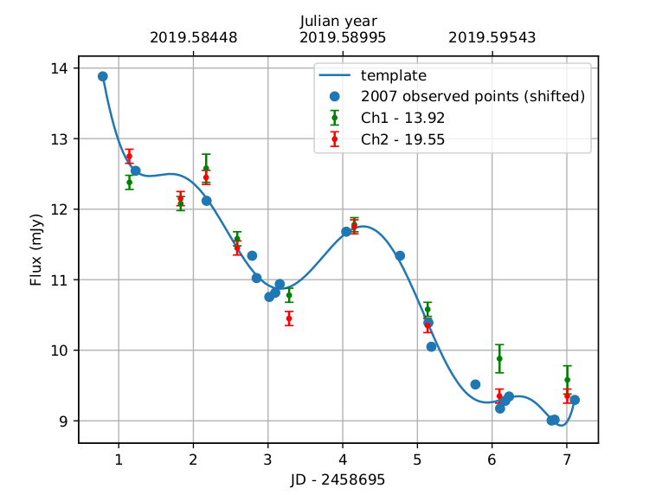
The Eddington Flare of 2019
The Spitzer observations were done in near-IR bands at 3.6 and 4.5 microns.
After taking into account the different properties of the flare in optical and near-IR band, we see that observed points nicely follow the predicted light curve.
We confirmed that the flare came within the predicted narrow time window, required in the BBH model.
Comparison between predicted and observed light curve (Laine, Dey et al. 2020, ApJL).
Introduction 2019 Spitzer Observation OJ 287 in Radio GWs from OJ 287 .

Slide 14
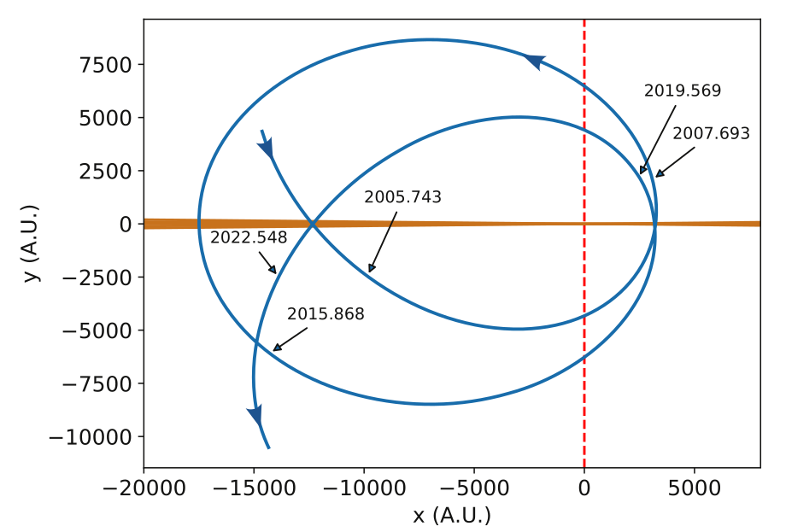
Implications of 2019 Flare and the Future
2019 flare would have appear 1.5 days earlier if we neglected the higher order radiation reaction terms in the PN-accurate EOM.
The next flare is predicted to happen during July 2022. Again, at that time OJ 287 will be close to the Sun.
Possible observational approaches are being explored.
(Laine, Dey et al. 2020, ApJL).
Introduction 2019 Spitzer Observation OJ 287 in Radio GWs from OJ 287 .

Slide 15
Can GMVA/EHT Campaigns Substantiate Our BBH Scenario for OJ 287?
Dey, Valtonen, Gopakumar et al. 2021, MNRAS; arXiv:2103.05274v3

Slide 16
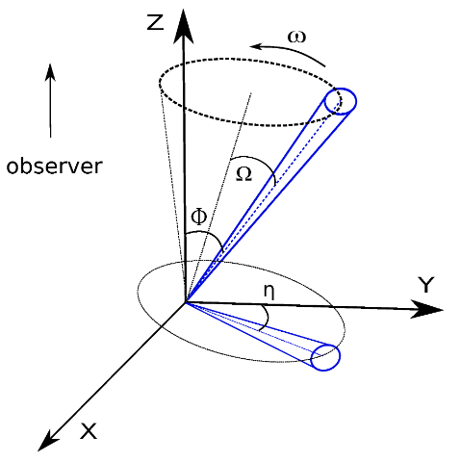
OJ 287 in Radio: Position Angle (PA)
The radio jet of OJ 287 has been under high resolution observation for last 30 years in 15 and 43 GHz and last 15 years in 86 GHz.
The position angle (PA) of the radio jet is defined as the angle between the projected jet on the sky plane and a fixed axis.
The PA of OJ 287’s jet shows systematic variations in all three frequencies.
Introduction 2019 Spitzer Observation OJ 287 in Radio GWs from OJ 287 .

Slide 17
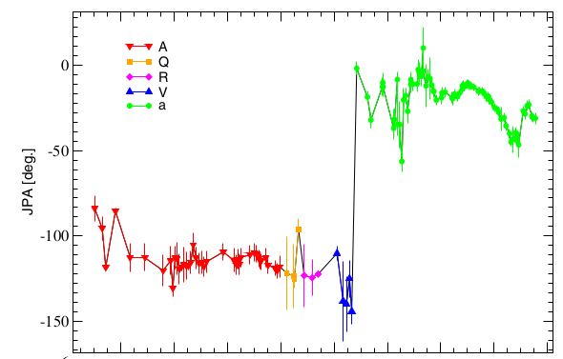
PA for 43 GHz radio jet in OJ 287
Similar kind of variations are also present in PA of the jet at 15 GHz and 86 GHz.
Can we model these variations too from the BBH model?
Agudo et al. 2014, ApJ
Introduction 2019 Spitzer Observation OJ 287 in Radio GWs from OJ 287 .

Slide 18
Modelling PA variations
The simplest explanation to variations in PA is precession of the jet. So we need to model the jet precession in our BBH scenario.
But, what determines the direction of the jet? We have considered two different models as the jet launching mechanism is not well understood.
1. Spin model: The direction of the spin of the primary BH determines the direction of the jet.
(Balndford & Znajek, 1977)
2. Disk model: The jet follows the direction of the angular momentum of the inner region of the accretion disk.
(Balndford & Payne, 1982)
Introduction 2019 Spitzer Observation OJ 287 in Radio GWs from OJ 287 .

Slide 19
The Spin Model
We use post-Newtonian equation of motion to model the precession of the primary BH spin in OJ 287.
Spin of the primary BH precesses according to
where
Introduction 2019 Spitzer Observation OJ 287 in Radio GWs from OJ 287 .

Slide 20
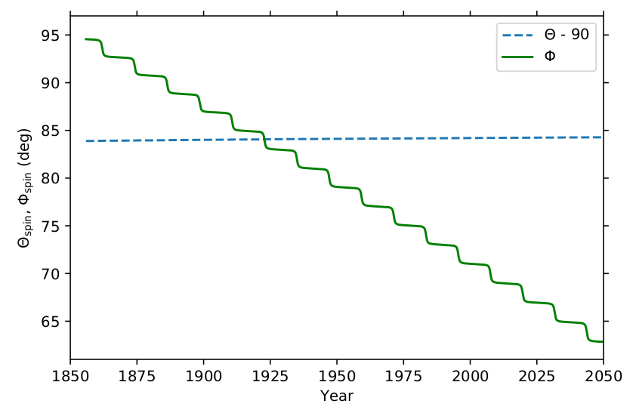
The Spin Precession
We took the accretion disk plane to be the X-Y plane. Then we determine the direction of the spin with two polar angles ϴ(t) and Φ(t).
The angle Θ(t) remains almost constant while Φ(t) decreases with time.
(Dey, Valtonen, Gopakumar et al. 2021, MNRAS)
Introduction 2019 Spitzer Observation OJ 287 in Radio GWs from OJ 287 .

Slide 21
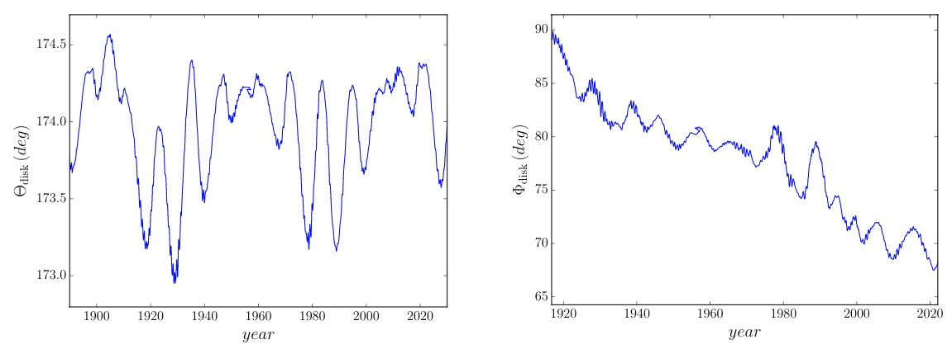
The Disk Model
We model the accretion disk as a cloud of point particles. The disk particles are evolved simultaneously with our binary BH.
Introduction 2019 Spitzer Observation OJ 287 in Radio GWs from OJ 287 .

Slide 22
Calculating PA
The PA depends on both the jet direction and the line of sight. The direction of the line of sight in our frame is determined by two angles ϴ_{obs} and Φ_{obs}.
Any change in the jet direction will take some time to propagate along the jet to be visible. We parameterize this time delay by Δt and it will be different for different frequencies.
We need one more parameter ΔPA to take into account the fixed direction from which PA is measured. ΔPA also depends on frequency due to bending of the jet.
We simultaneously fit for PAs in all three frequency observations (86, 43 & 15 GHz). For that we need in total 8 parameters to be fitted.
Introduction 2019 Spitzer Observation OJ 287 in Radio GWs from OJ 287 .

Slide 23
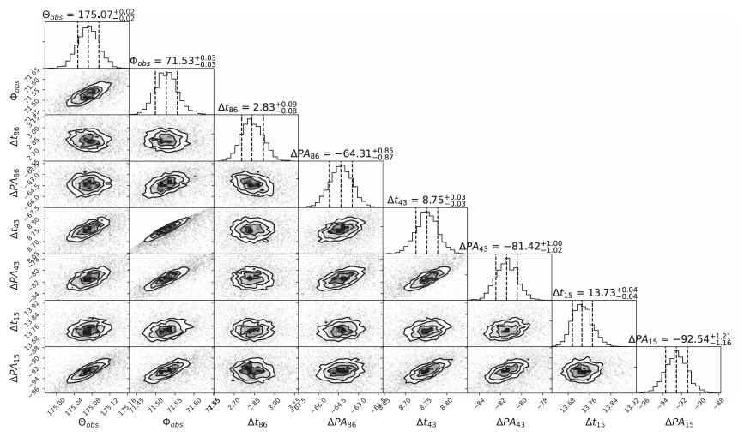
Posterior Distribution (Spin Model)
Introduction 2019 Spitzer Observation OJ 287 in Radio GWs from OJ 287 .

Slide 24
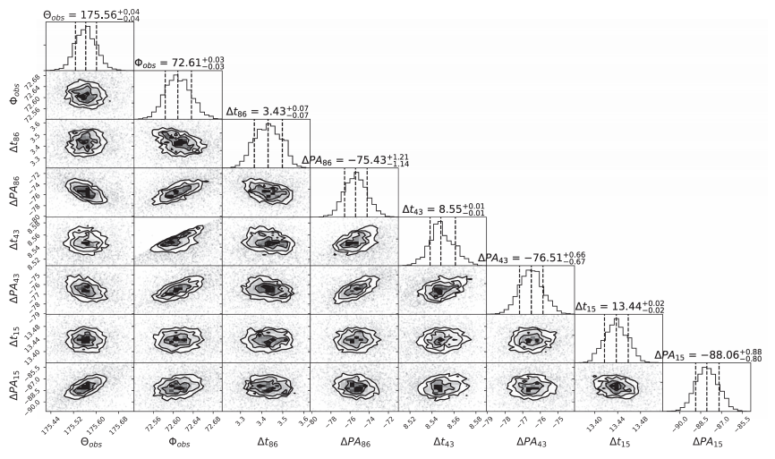
Posterior Distribution (Disk Model)
Introduction 2019 Spitzer Observation OJ 287 in Radio GWs from OJ 287 .

Slide 25
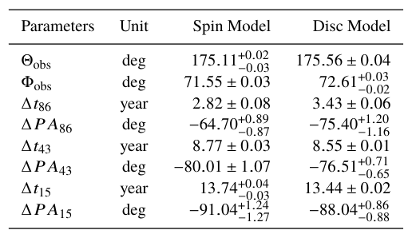
Estimated Parameters from a Bayesian Analysis
ϴ_{obs} and Φ_{obs} have similar values for both Spin and Disk models.
The time delay Δt is minimum for maximum frequency (86 GHz) and increases with decreasing frequency.
Dey, Valtonen, Gopakumar et al. 2021, MNRAS
Posteriors do follow astrophysical expectations.
Introduction 2019 Spitzer Observation OJ 287 in Radio GWs from OJ 287 .

Slide 26
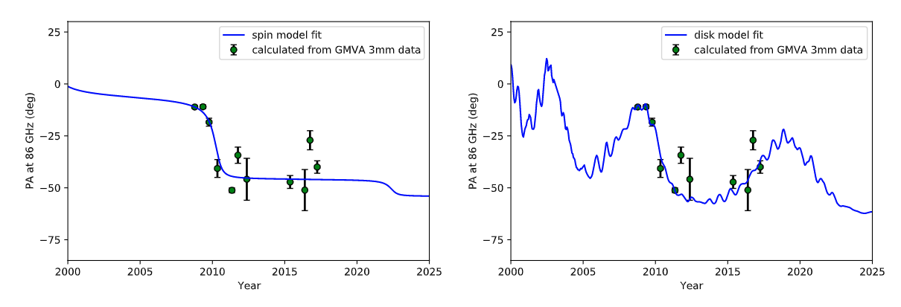
Fits for PA: 86 GHz
Ongoing and upcoming GMVA observations will be able to verify.
Gomez et al. (in prep.)
Introduction 2019 Spitzer Observation OJ 287 in Radio GWs from OJ 287 .

Slide 27
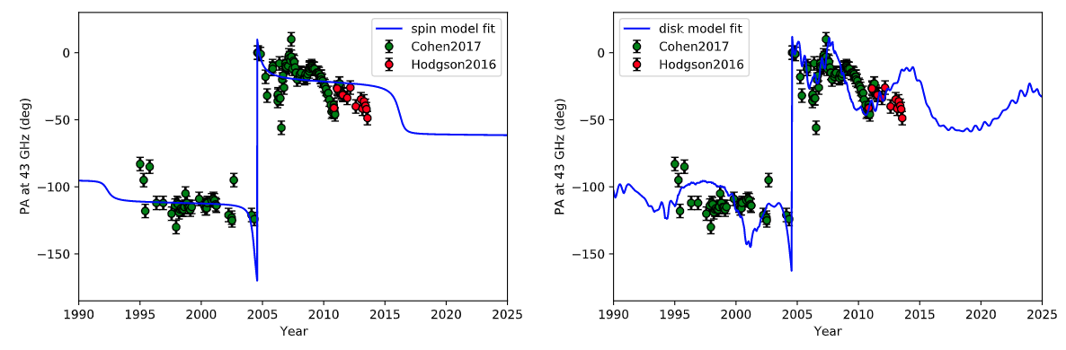
Fits for PA: 43 GHz
BBH model of OJ 287, developed essentially from optical observations, can also explain the variations in the jet observed at different radio frequencies.
Introduction 2019 Spitzer Observation OJ 287 in Radio GWs from OJ 287 .

Slide 28
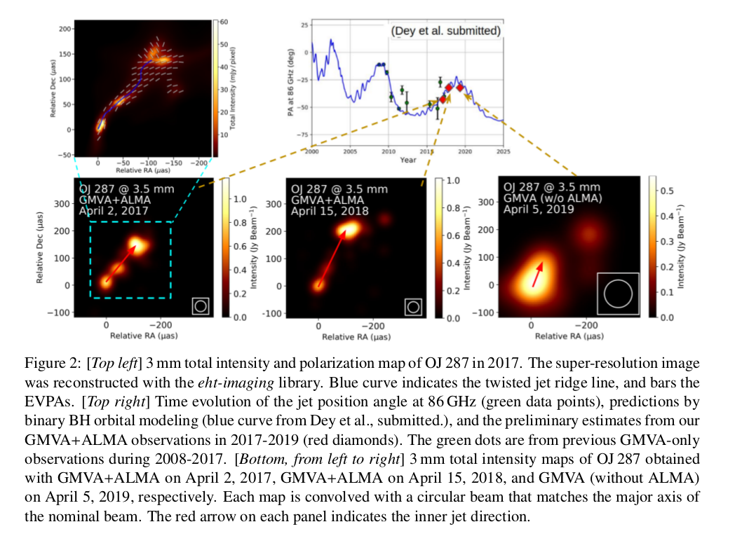
Preliminary Results
J. L. Gomez+ (2021)
Introduction 2019 Spitzer Observation OJ 287 in Radio GWs from OJ 287 .

Slide 29
Implications for the EHT Campaigns
OJ 287 is one of the non-horizon sources for the Event Horizon Telescope consortium that published the first ever image of the shadow of a BH in 2019.
EHT observations of OJ 287 are done at very high radio frequency (230 GHz) and our analysis can be tested with those observations too.
Additionally, if the secondary BH supports a temporary jet due to accretion from the disk during the impacts, it is possible to see an emerging secondary component in EHT radio maps of OJ 287 (On-going investigations)
Introduction 2019 Spitzer Observation OJ 287 in Radio GWs from OJ 287 .

Slide 30
Modelling PTA signal induced by GWs from OJ 287
Dey, Susobhanan, Gopakumar et al. (in prep.)

Slide 31
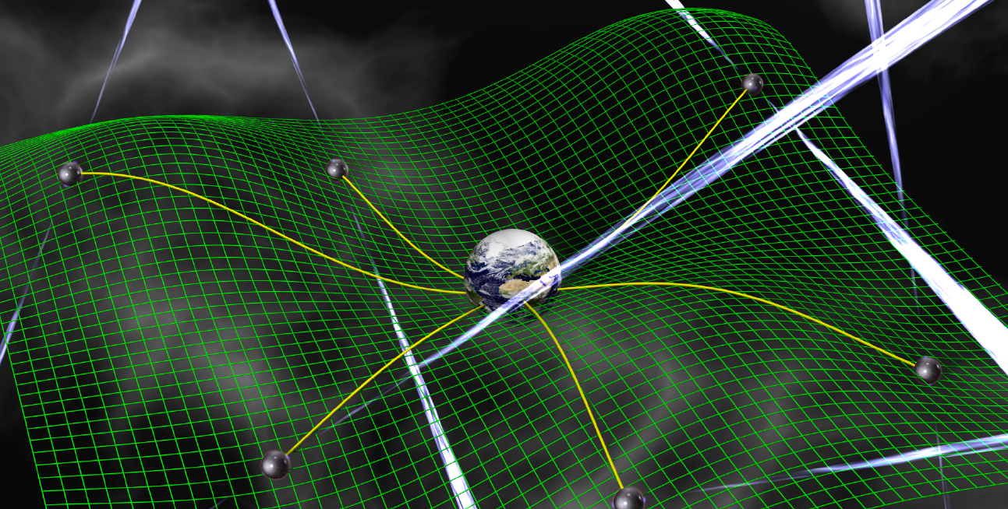
GWs from OJ 287
Being an inspiralling supermassive BBH, OJ 287 emits GWs at nano-Hz frequencies.
Pulsar Timing Array aims to detect low-frequency GWs emitted from such binaries.
It observes a bunch of millisecond pulsars and searches for correlated signatures in the TOAs to detect GWs.
Pulsar Timing Array (Source: Google Image)
Introduction 2019 Spitzer Observation OJ 287 in Radio GWs from OJ 287 .

Slide 32
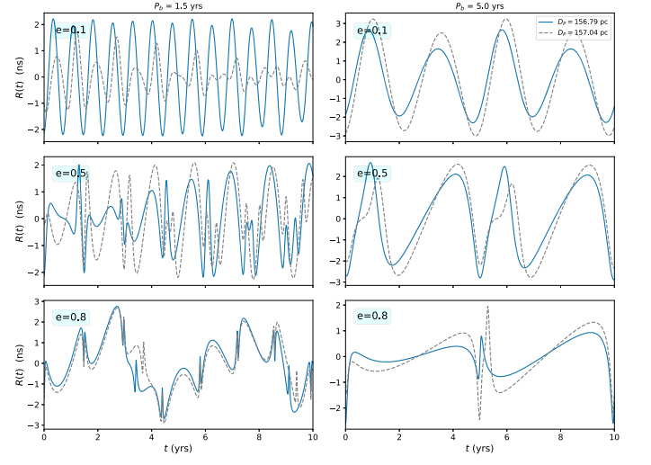
GWs from non-spinning SMBHBs in eccentric orbit
Susobhanan et al. 2020 (PRD)
Ongoing search for GWs from SMBHBs in PN-accurate eccentric orbits in NANOGrav 12.5 year data (Cheeseboro+)
We have extended Susobhanan et al. (2020) by incorporating the dominant order spin effects
Introduction 2019 Spitzer Observation OJ 287 in Radio GWs from OJ 287 .

Slide 33
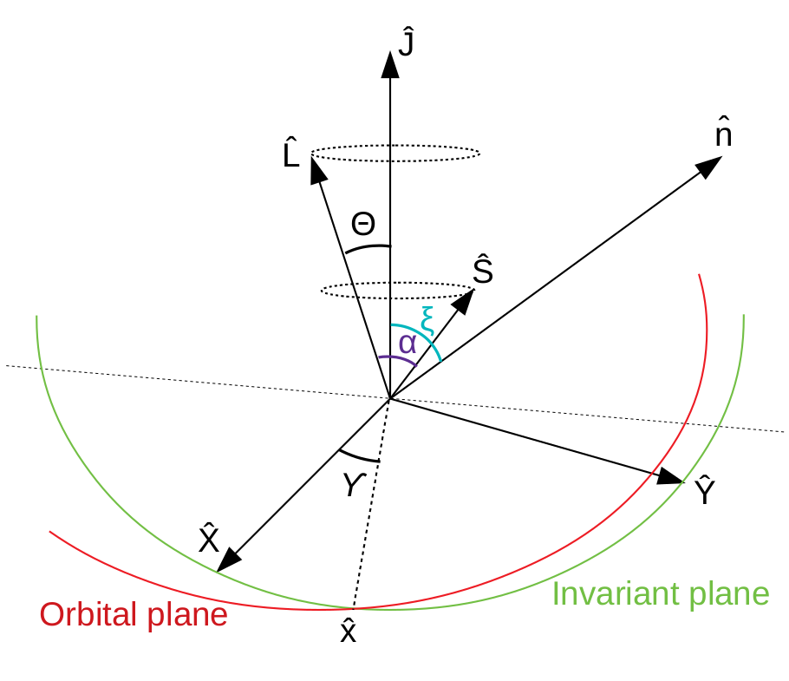
Conservative dynamics of spinning BH binaries
We include the effect of leading order GR spin-orbit interactions
Two mass-spin configurations:
Equal mass, two arbitrary spins
Arbitrary masses, one is spinning (Königsdörffer & Gopakumar, 2005)
Direction of J = L + S is conserved, L and S precesses around J
Spin-orbit interaction also contributes to the advance of pericenter
Dey, Susobhanan, Gopakumar +
Introduction 2019 Spitzer Observation OJ 287 in Radio GWs from OJ 287 .

Slide 34
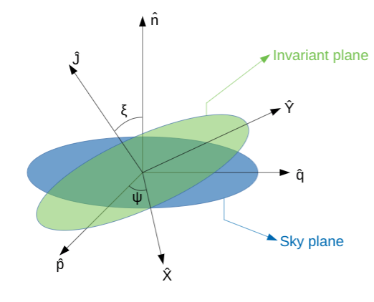
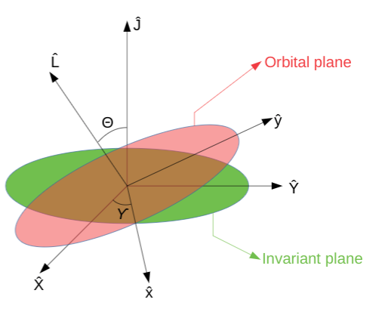
Effects of GW emission
We Orbital period and eccentricity decreases with time
|L| also decreases with time => J is not conserved anymore
All these evolutions are determined by solving seven coupled differential equations for: n, e, l, γ, ξ, Ψ and ϒ
We use GW waveform for spinning binaries (Königsdörffer & Gopakumar, 2005) to calculate the induced PTA signal
Introduction 2019 Spitzer Observation OJ 287 in Radio GWs from OJ 287 .

Slide 35
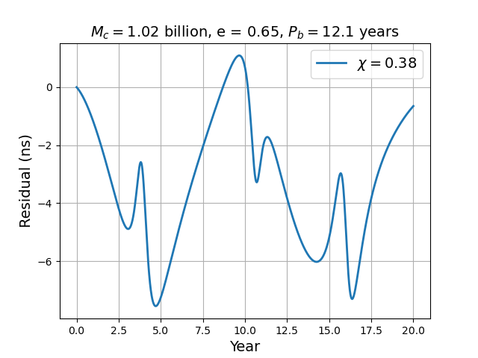
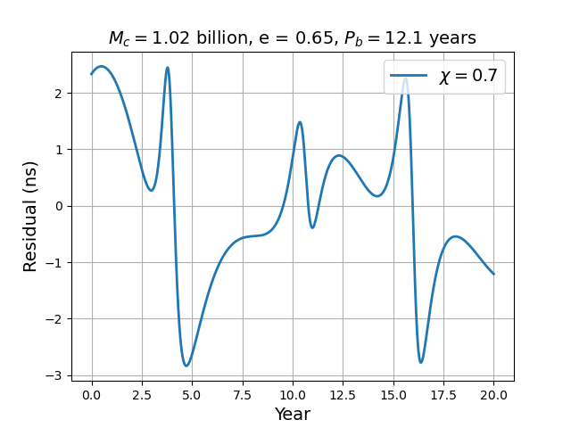
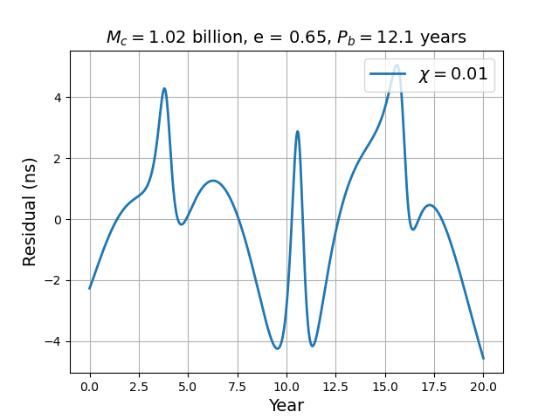
PTA signal due to OJ 287
For Pulsar J0613-0200
Dey, Susobhanan, Gopu+ (in prep.)
Introduction 2019 Spitzer Observation OJ 287 in Radio GWs from OJ 287 . .

Slide 36
Summary
The 12 year quasi periodic optical flares in OJ 287 implied that the central engine of OJ 287 is a SMBHB. The BBH model successfully predicted last three flares in OJ 287, latest one during 2019.
The radio observation of jet of OJ 287 at different frequencies can be explained from the BBH model developed form its optical observation.
We can model the PTA response to GWs emitted by OJ 287 and search for such signals in PTA data set and its detection will certainly help us to understand SMBHB dynamics in more details.
OJ 287 certainly has the potential to inaugurate the field of multi-messenger nano-Hz GW astronomy.
Introduction 2019 Spitzer Observation OJ 287 in Radio GWs from OJ 287 .

